Slide 1
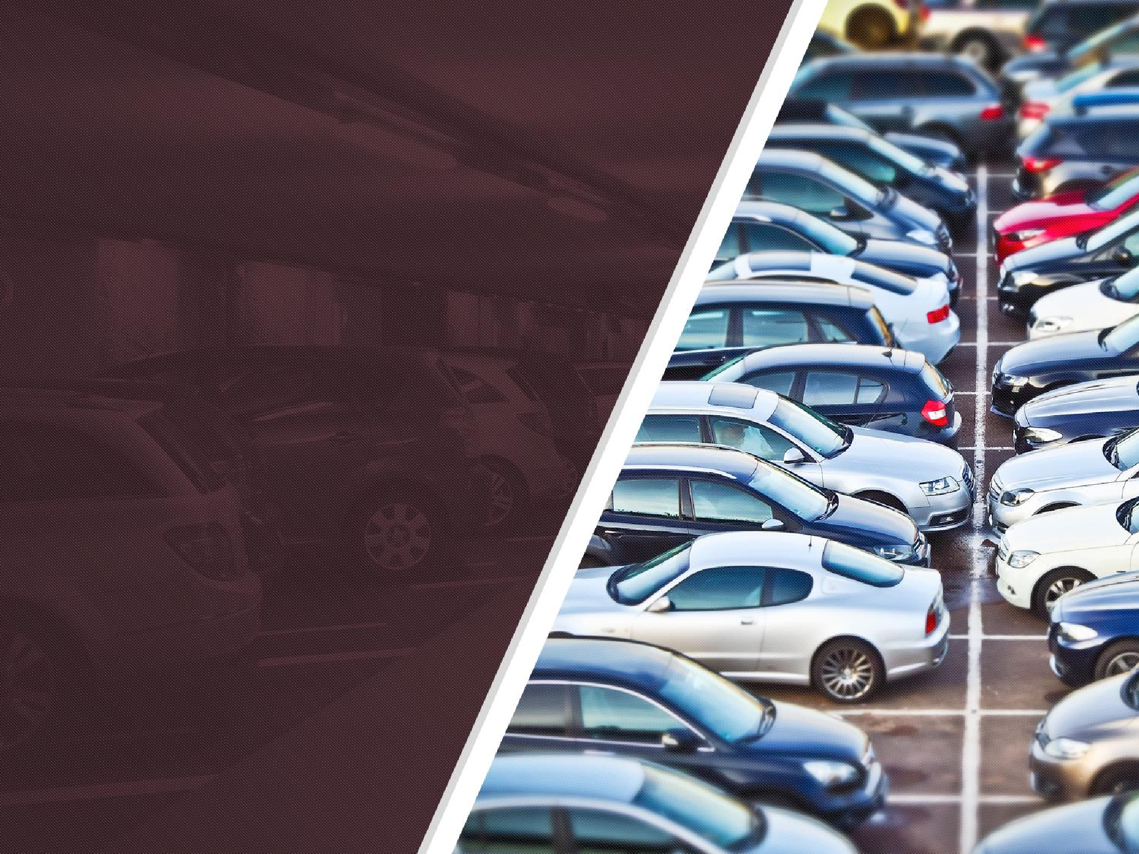
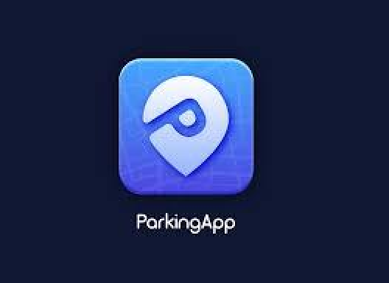
SAND Digital Parking Innovation
An innovative car parking Innovation designed to improve parking
facility efficiency and reduce customer wait time
DURATION 01/01/2023 – 06/01/2023
POWER POINT PRESENTATION
30TH NOV.2023

Slide 2
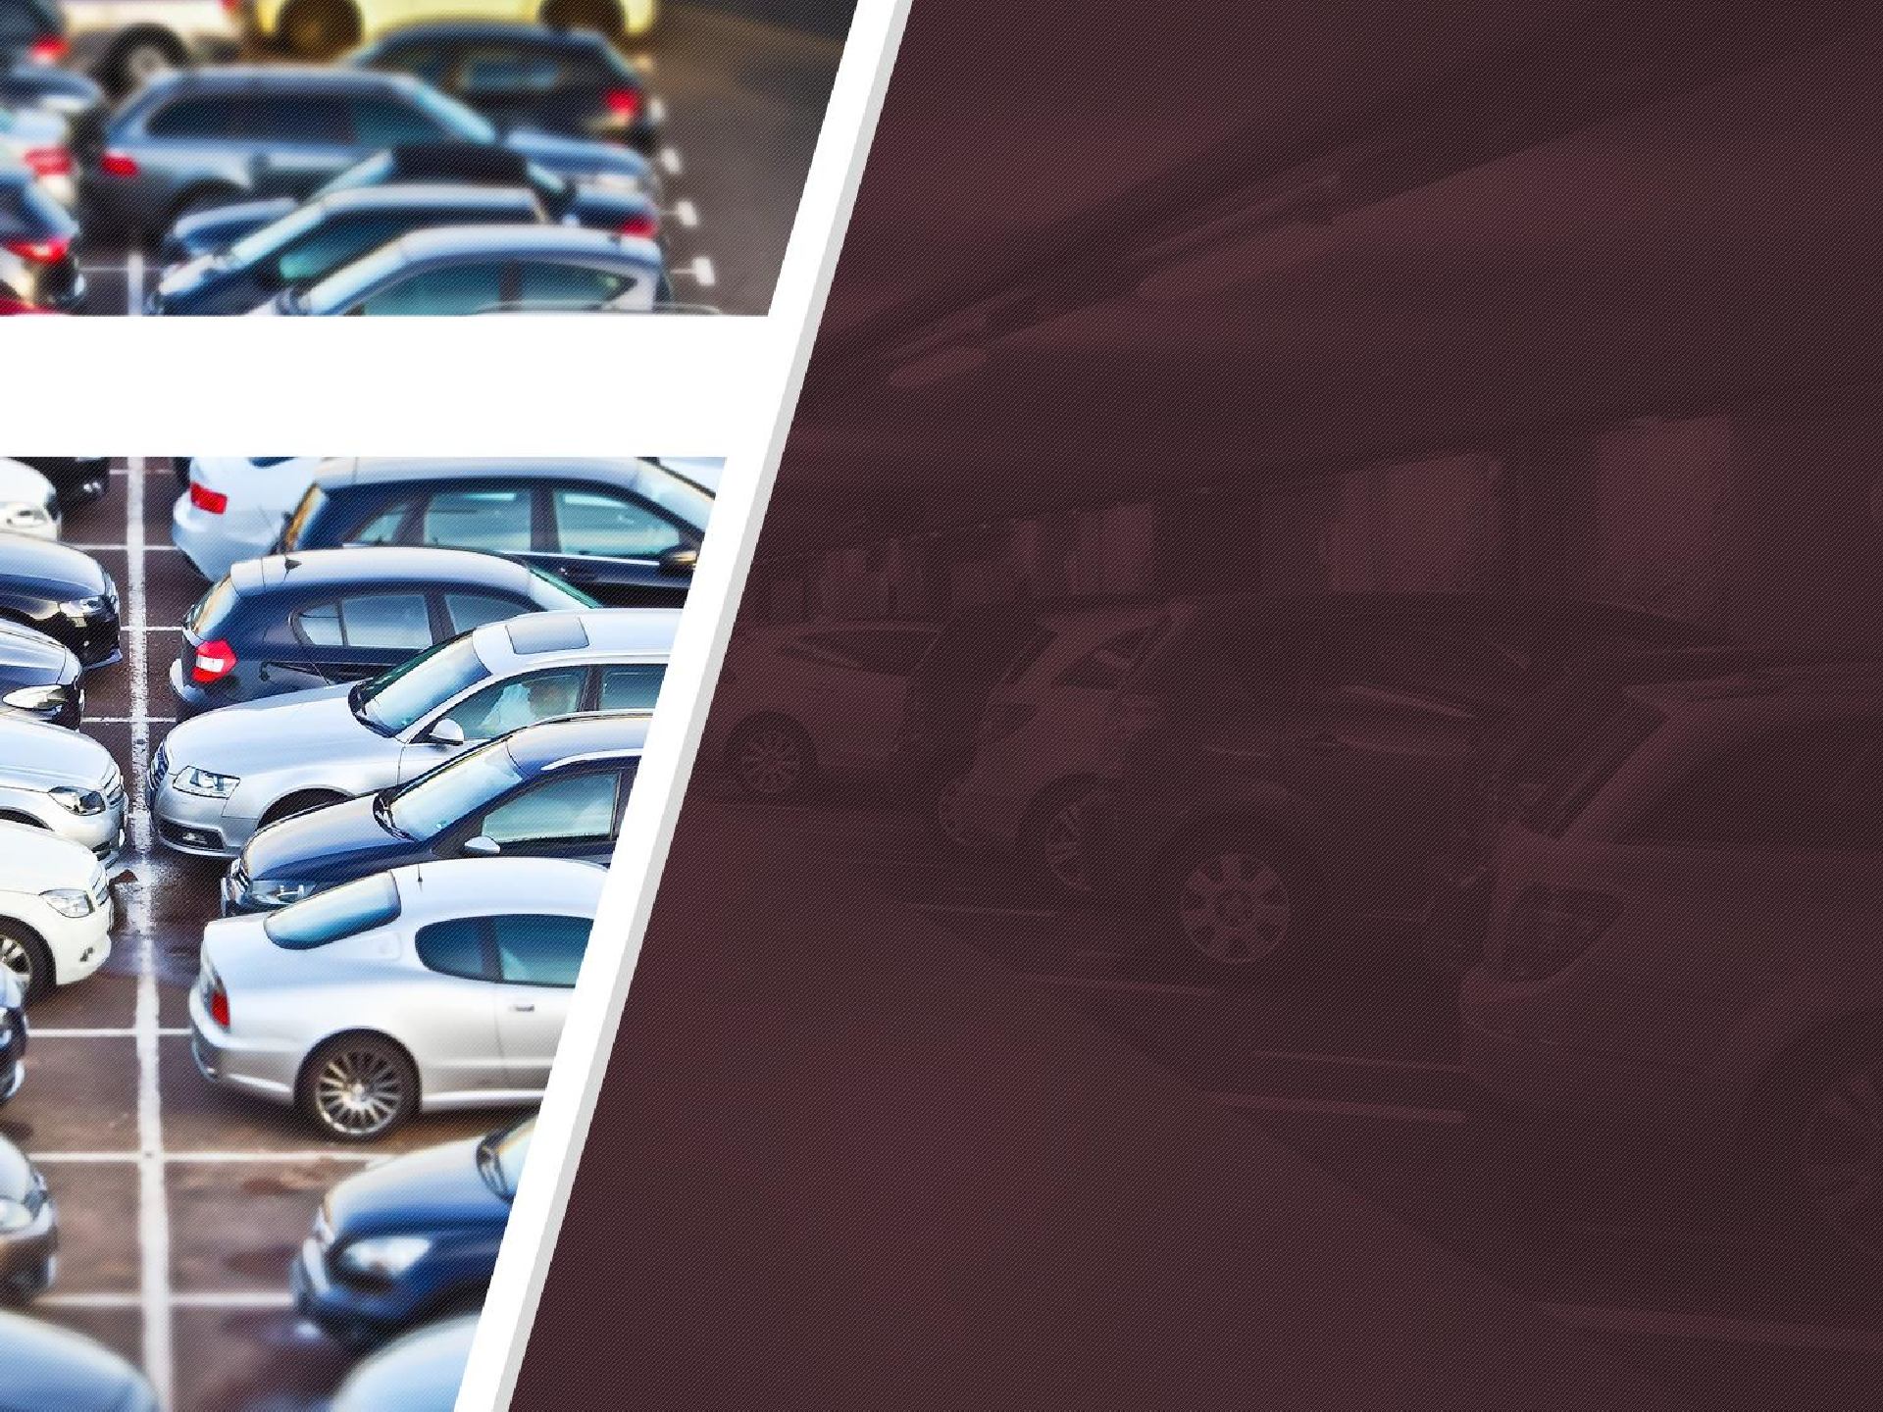
CONTENTS
01
Who we are
02
Summary
03
Key industry facts
04
What is the problem/challenge?
05
Our Solution
06 Benefits to key stakeholders

Slide 3

Who we are
Digital Parking Innovation
We are the world's first scheduler and planner, as well as mobile booking App with an AI algorithm.
Our integrated software helps organizations and its security personnel effectively manage their parking space to its maximum potential digitally.
Digital Parking Application is projected to have a market value of $19.9 billion, if deployed for use in select locations.
We integrate with business application and IoT-powered tools to provide a unified and connected experience in parking lots. We offer a hybrid parking lot Experience.

Slide 4
Summary
Digital Parking Innovation
We use SaaS cloud-based technology for a cost-effective opportunity to improve efficiencies in parking management and enforcement, promote compliance and increase revenue.
We will make this app available through a subscription-free model, so that customers can download the app at any time.
We uses SaaS products because its easy to install and use and can be accessed from mobile or handheld devices.
We also provide free automatic software updates regularly.

Slide 5

Key facts
Annual sales of passenger cars in the USA increased by 6.5 and 11.5 percent, respectively. As a result, there are many cars on the street looking for a parking space.
The global parking garage market is expected to grow from $86 billion in 2021 to $92 billion this year. With an automated fleet like ours, it becomes seamless.
Many cities were planned before the automobile was invented and became the most popular form of transportation. As a result, cars have exceeded the plans for urban transport.
Some cities are now metropolises and government buildings, and land does not always have space for parking infrastructure.
.

Slide 6

The Challenge/Problem
.
High parking fees
Traffic congestion due to customers/guests searching for space, especially in large stores and cities Lack of parking
Business owners find it difficult to find available parking for their customers, resulting in less foot traffic.
Unallotted parking by individuals who are not supposed to park in the space that is provided .

Slide 7

Our Solution
.
The DAP solution is to digitize and automate how cars can find a parking space from their app but also be assured that it will be there till they arrive.
With the use of AI and SaaS software, companies will be able to see ,scan and assign cars, the sensor will easily identify when there is a problem.
When the vehicle is not in its parking lot before 10-15mins of its slot time, then the slot would automatically open for new booking.
With the use of our sensors on the parking lot for each car, there will be reduction in the frequent parking of unallotted cars on the company’s parking lot.

Slide 8

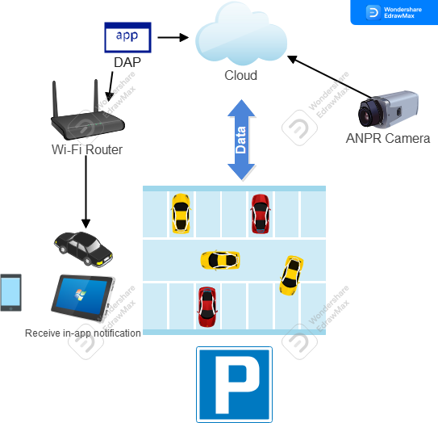
DAP High-Level Architecture

Slide 9
THANK YOU

